Slide 1
Course : MOBI8001 – Mobile Technology and Cloud Computing
Offloading in Mobile Cloud Computing
Session 05
D5727- Dr. Eng. Nico Surantha, ST., MT.

Slide 2
Reference
[1] DE, Debashis. Mobile cloud computing:architectures, algorithms and applications. CRC Press, 2016.
[2] Ma, Y. Cui, L. Wang, and I. Stojmenovic, Energy optimizations for mobile terminals via computation offloading, in Second IEEE International Conference on Parallel Distributed and Grid Computing, Solan, India, pp. 236–241, 2012.
[3] K. Kumar, J. Liu, Y. H. Lu, and B. Bhargava, A survey of computation offloading for mobile systems, Mobile Networks and Applications, 18(1), 129–140, 2013.

Slide 3
Outline
Introduction
Offloading decision
Types of offloading
Topologies in Offloading
Offloading in CC and MCC
Adaptive Computation Offloading
Cloud Path Selection
Mobile Data Offloading using Opportunistic communitation
Three-tier architecture
Requirements of data offloading
Performance analysis of offloading technique
Multi-Cloud Offloading in MCC environment
Conclusion
Bina Nusantara University

Slide 4
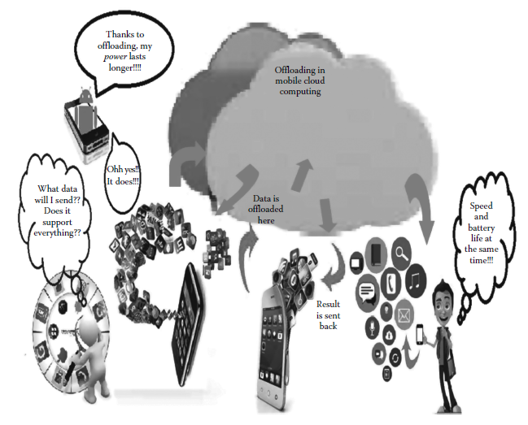
Introduction

Slide 5
Introduction (2)
storage resources of mobile, and serious power constraints due to limited battery lifetime are the major contributors to problem in mobile computing
Offloading as distributed computing can be used to solve this problem.
Offloading refers to a mechanism where data storage and computations are done inside the remote cloud instead of the mobile device.
Bina Nusantara University

Slide 6
Introduction (3)
For grid computing or thin client, they offload the computation process to the server in the same environment
For cloud computing, the offload the computation process to the server spread all over the world

Slide 7
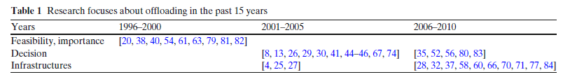
Introduction 4
Offloading state-of-art:
1996-2000: Feasibility, importance
2001-2005: Decision
2006-2010: Infrastructures
Reference: K. Kumar, J. Liu, Y. H. Lu, and B. Bhargava, A survey of computation of oading for mobile
systems, Mobile Networks and Applications, 18(1), 129–140, 2013.

Slide 8
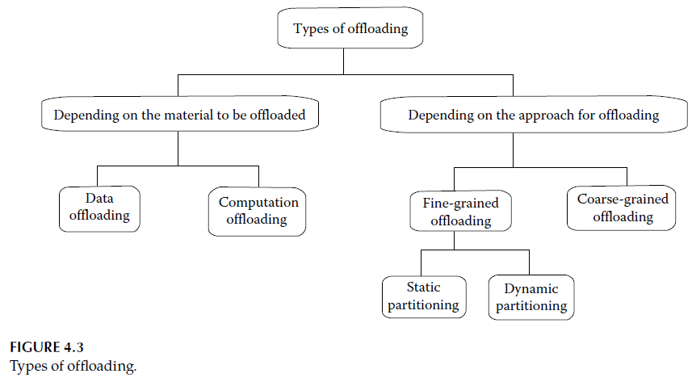
Types of Offloading

Slide 9
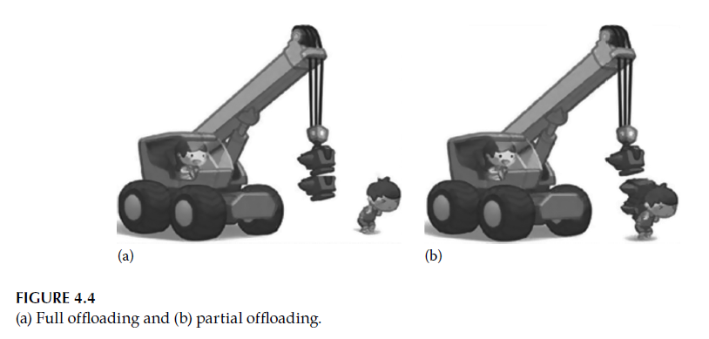
Types of Offloading (2)
Full offloading/coarse-grained offloading: the full program is migrated to the infrastructure, and then the programmer cannot modify the source code.
Partial offloading/fine-grained offloading: partitioning a program and offloading only the power-hungry parts of the application.

Slide 10
Types of Offloading (3)
 | Static partitioning | Dynamic partitioning
When ? | When the program is developed | When the program is running
Overhead time | Low | High, due to offloading calculation
Accurary | Only valid if the parameters can be accurately estimated (parameter w, d, and B may vary) | Can predict accurately for every run-time conditions.
Predictionn algorithm for static partitioning:
- Probabilistic prediction , history-based prediction , and fuzzy control [26].

Slide 11
Types of Offloading (4)
Full offloading/coarse-grained offloading:
Does not require estimating the computation time prior to the execution
Instead, the program is initially executed on the portable client with a timeout. If the computation is not completed after the timeout, it is offloaded to the server.
The timeout is first set to be the minimum computation time that can benefit from offloading.
Advantage: low-overhead
Limitation : The timeout wastes energy for the computation instances that are eventually offloaded

Slide 12
Offloading Decision
Improving performance
Saving energy

Slide 13
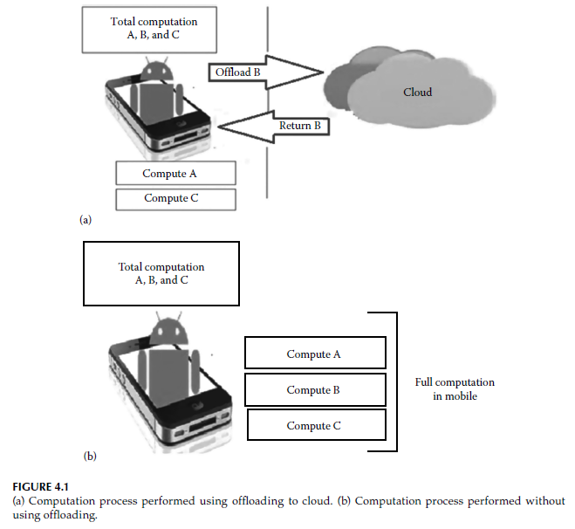
Offloading Decision (2)
Improving performance

Slide 14
Offloading Decision (3)
Improving performance
  Offloading becomes an attractive solution for meeting response time requirements on mobile systems as applications become increasingly complex, while mobile systems has limited computing speeds.
  Example: a navigating robot may need to recognize an object before it collides with the object; if the robot’s processor is too slow, the computation may need to be offloaded.

Slide 15
Offloading Decision (4)
The condition for offloading can be formulated as follows:
  First part: Part of SW must run on mobile system, e.g. user interface and code that handles peripherals
  Second part: Part of SW that may be offloaded
This case also called as partial offloading

Slide 16

Offloading Decision (5)
Therefore we can calculate as follow
  Time to execute the second part of the mobile system (T)
  Where:

Slide 17
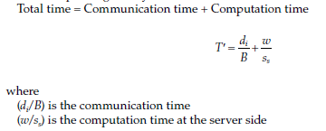

Offloading Decision (6)
Therefore we can calculate as follow
  Time to oflload and execute the second part (T’)

Slide 18

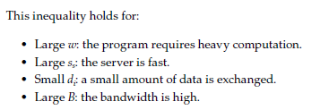
Offloading Decision (7)

Slide 19
Offloading Decision (8)
Offloading is meaningful in response time requirement if we can get the performance gain which is shown as below.

Slide 20
Offloading Decision (9)
Saving energy
  Recently, developing smartphone systems having a large number of functionalities consume more power and shorten the battery life.
  Offloading can extend the battery life by transferring the energy-intensive parts of the computation to the servers.

Slide 21
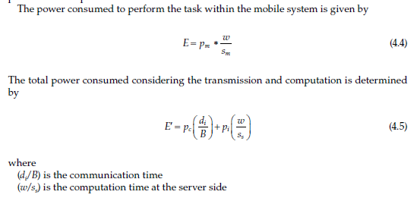
Offloading Decision (10)

Slide 22
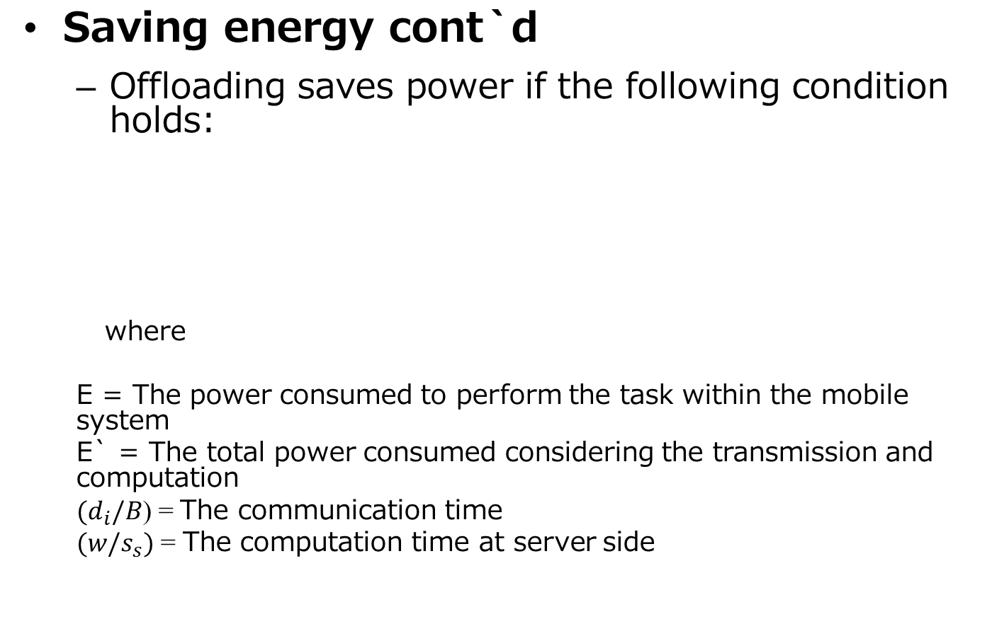
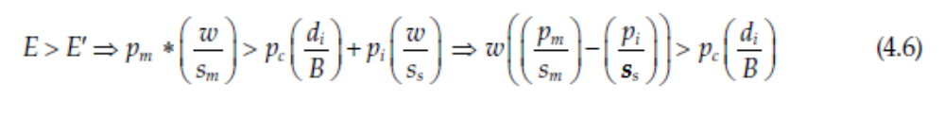
Offloading Decision (11)
Offloading is benneficial if w is large, but d is small

Slide 23
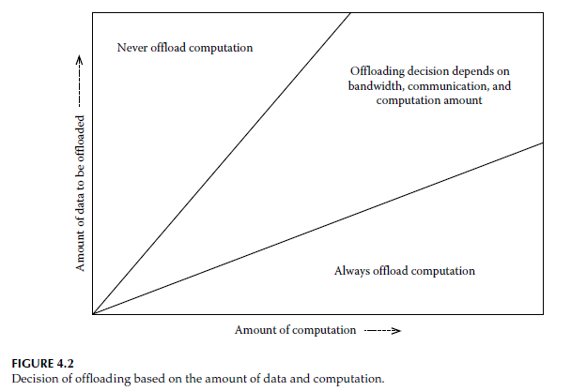
Offloading Decision (12)
where computation is high, full offloading should be used and
where moderate computation is required, partial offloading can be done.

Slide 24
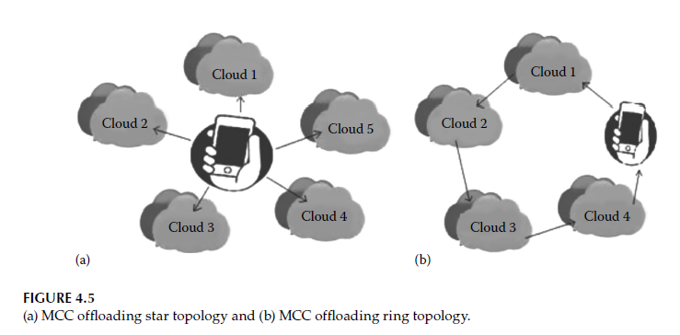
Topologies of Offloading

Slide 25
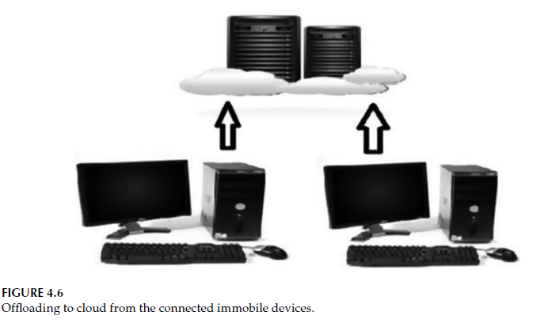
Offloading in CC and MCC

Slide 26
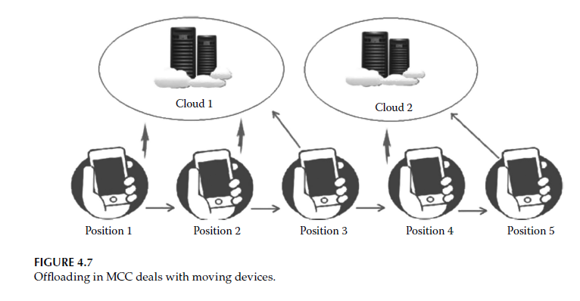
Offloading in CC and MCC (2)
In the case of offloading in a mobile cloud computing paradigm, the change in the network is an essential factor
As with the change in network, the server that the device accesses changes and the need for a constant calculation of energy optimization techniques also arises.

Slide 27
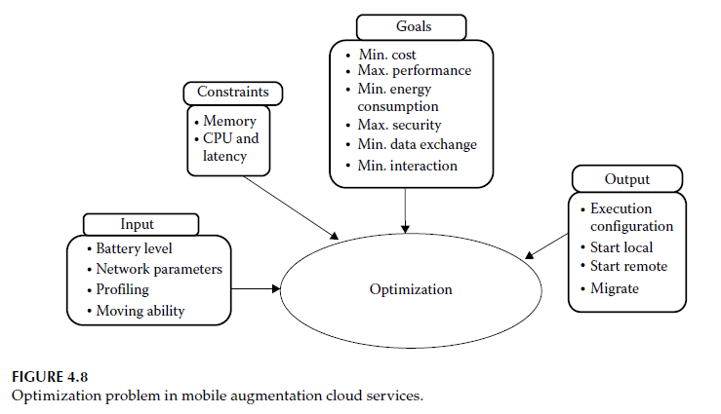
Adaptive Computation Offloading from Mobile Devices
Mobile Augmentation Cloud Services (MACS) is a middleware that enables adaptive extension or optimization

Slide 28
Mobile Augmentation Cloud Services
MACS middleware is capable of making Android applications offloadable and supports seamless adaptive computation offloading
The decision for partitioning is approached as an optimization problem according to the input on the conditions of cloud side and mobile devices, such as available memory, CPU load, and remaining battery power of devices, bandwidth between the cloud and mobile devices.
Finally, based on the solution to the optimization problem, this middleware offloads parts to the remote clouds and returns the corresponding results back.
Notes:
The decision for partitioning is approached as an optimization problem according to the
input on the conditions of cloud side and mobile devices, such as available memory, CPU
load, and remaining battery power of devices, bandwidth between the cloud and mobile
devices.

Slide 29
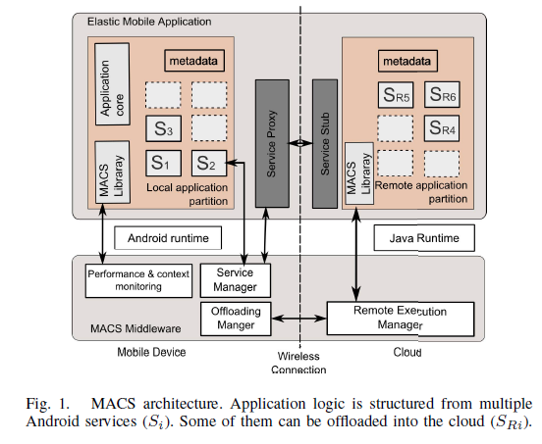
Mobile Augmentation Cloud Services (2)
Elastic mobile application
  Capable of partial partitioning
  Capable of dynamic partitioning
MACS application consist of:
  an application core (Android activities, GUI, access to devices sensors)
  Multiple services (Si)
D. Kovachev, T. Yu, and R. Klamma, Adaptive computation of!oading from mobile devices into the cloud, in Tenth International Symposium on Parallel and Distributed Processing with Applications, Leganes, Spain, pp. 784–791, 2012.
Notes:
The decision for partitioning is approached as an optimization problem according to the
input on the conditions of cloud side and mobile devices, such as available memory, CPU
load, and remaining battery power of devices, bandwidth between the cloud and mobile
devices.

Slide 30
Mobile Augmentation Cloud Services (3)
As service-based implementation is adopted, for each service
we can profile following Metadata which is obtained by monitoring the application execution and environment:
type: whether can be offloaded or not
memory cost: the memory consumption of the service on the mobile device
code size: size of compiled code of the service
dependency information on other services:
– transfer size: amount of data to be transferred
– send size: amount of data to be sent
– receive size: amount of data to be received
Notes:
The decision for partitioning is approached as an optimization problem according to the
input on the conditions of cloud side and mobile devices, such as available memory, CPU
load, and remaining battery power of devices, bandwidth between the cloud and mobile
devices.

Slide 31
Mobile Augmentation Cloud Services (3)
MACS allows dynamic application partitioning at runtime; it monitors the execution of the services and the environment parameters.
At the cloud side, the MACS middleware handles the offload requests from the clients, installs and then initializes the offloaded services, and invokes the methods.
MACS middleware monitors the resources on the mobile execution environment and available clouds.
It then forms the optimization problem whose solution will decide whether the service that contains the called function should be offloaded or not
Notes:
The decision for partitioning is approached as an optimization problem according to the
input on the conditions of cloud side and mobile devices, such as available memory, CPU
load, and remaining battery power of devices, bandwidth between the cloud and mobile
devices.

Slide 32
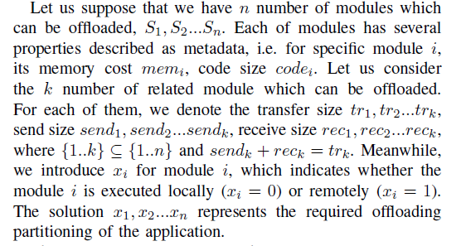
Adaptive Computation Offloading
The offloading algorithm can be modeleds as follow

Slide 33
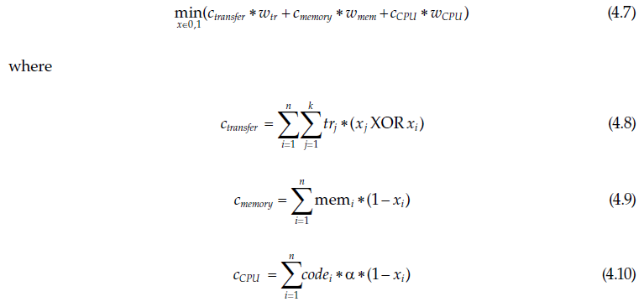
Adaptive Computation Offloading
Partial computing where only the power-hungry parts are sent to the cloud for offloading, depending on certain conditions
The calculation can be represented by following cost function

Slide 34



Adaptive Computation Offloading (2)
Three constraints considered in this case
  Minimized memory usage: The memory cost of resident service should not be more than the available memory of the mobile device, that is
  Minimized energy usage: the energy consumption of offloading should not be greater than the case where offloading is not used and local execution occurs, that is,
  Minimized execution time: This is enabled when the user prefers very fast execution, that is,

Slide 35
Adaptive Computation Offloading (3)
Offloading can lower the CPU load on a mobile device significantly. It also saves lots of energy, which indicates that the battery time can be increased compared to the local execution.
With the increase in needed computation, it is better to push those computations that utilize considerable resources to the remote cloud.
The more computation is needed, offloading has more advantage. The overhead of this framework is small and acceptable.

Slide 36
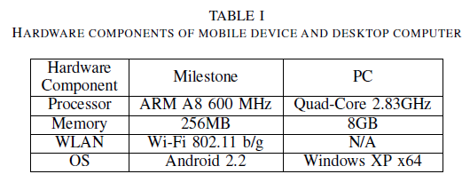
Adaptive Computation Offloading (4)
The evaluation contains 2 use cases:
  N-queens problem
  .
Setup of the evaluation

Slide 37
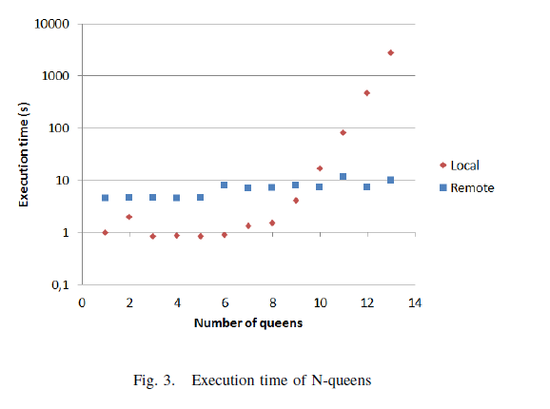
Adaptive Computation Offloading (5)

Slide 38
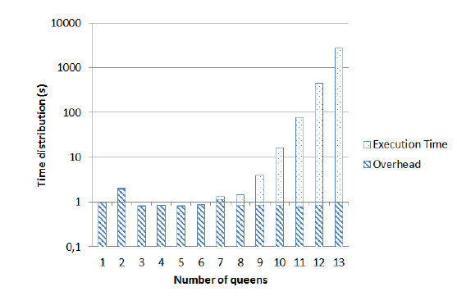
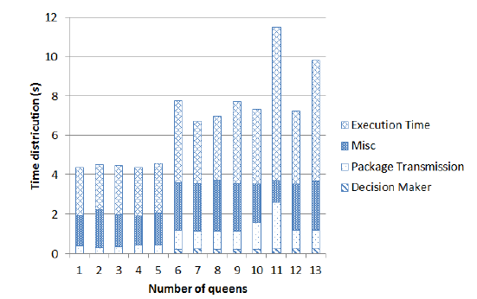
Adaptive Computation Offloading (6)
Local execution
Remote execution

Slide 39
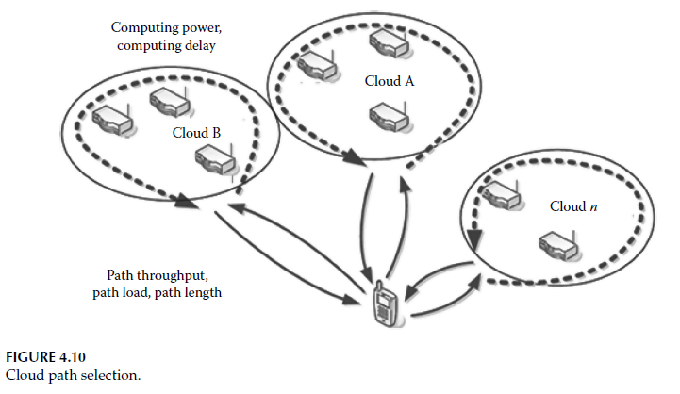
Cloud Path Selection for Offloading

Slide 40
Cloud Path Selection for Offloading (2)
Along with the development of cloud computing, offloading has become a more attractive way to extend the battery life and reduce the execution time on mobile devices.
But a large number of clouds appear in the sky with different charging and conditions, and offloading the same program to different clouds may result in different amounts of computing within the same duration due different cloud speeds, and may cost different communication time due to bandwidth and cloud availability.
Therefore, an optimal cloud path selection method is needed when choosing the best cloud.

Slide 41
Cloud Path Selection Methods
Random: Select the cloud path pair randomly.
Bandwidth dependent: Choose the cloud path pair with the highest bandwidth.
Link failure rate dependent: Select the cloud path pair with the lowest link failure rate.
Speedup factor dependent: Select the cloud path pair with the highest speedup factor.
Cost dependent: Select the cloud path pair with the lowest cost.

Slide 42
Cloud Path Selection Issues
Bandwidth: It depends on the wireless link between the mobile devices and cloud.
Price:the cost for the same amount of computing and its variation in different cloud services.
Speed: It presents how fast a server can compute on cloud.
Security: need to select which data to offload, for example non-sensitive data.
Availability:It is related to the link’s failure and cloud’s unavailability during the whole offloading process.

Slide 43
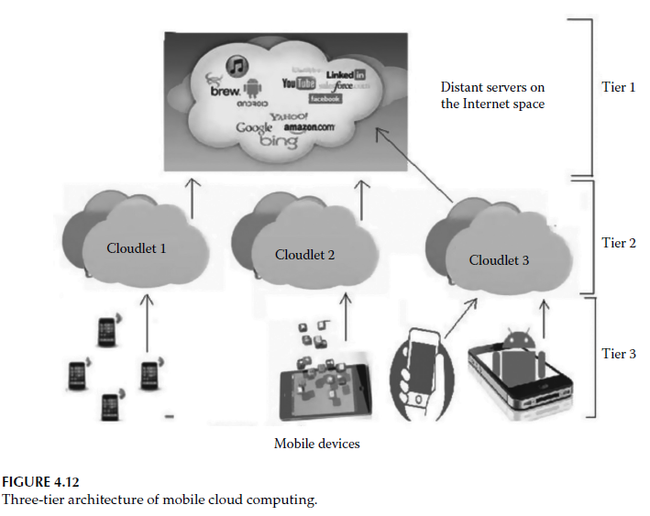
Three-Tier Architecture of Mobile Cloud Computing

Slide 44
Requirements of Data Offloading
Energy optimization is one of the important reasons for offloading.
Mobile cloud computing through offloading saves processing energy, which is one of the most significant ways to minimize power consumption.
The solution proposed for various mobile computational environment changes considers three common environmental changes: client-side power level, connection status, and bandwidth.
The highest priority is given to the client-side power levels as they are irreversible.

Slide 45
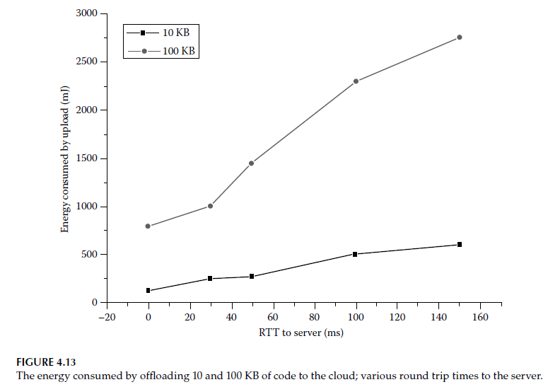
Performance Analysis of Offloading Techniques
The energy consumption of code offloading grows almost linearly with the round trip time (RTT).

Slide 46
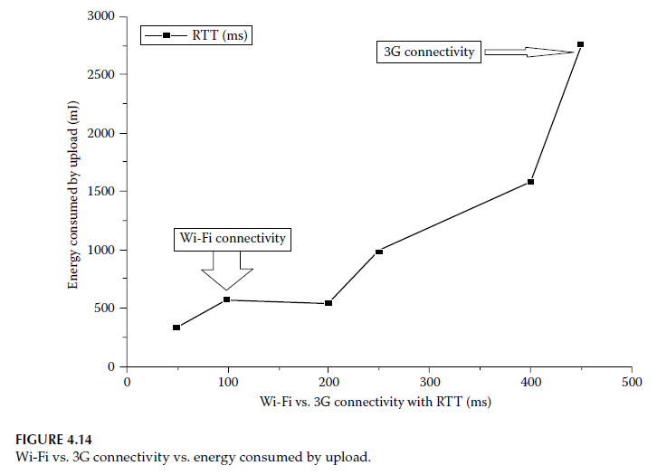
Performance Analysis of Offloading Techniques (2)
Notes:
From this result, two important decisions can be reached:
Cloud providers should strive to minimize the latency to the cloud for mobile users as shorter RTTs can lead to significant energy savings.
The benefits of remote execution are most impressive when the remote server is nearby, such as on the same LAN as the Wi-Fi access point, rather than in the cloud.

Slide 47
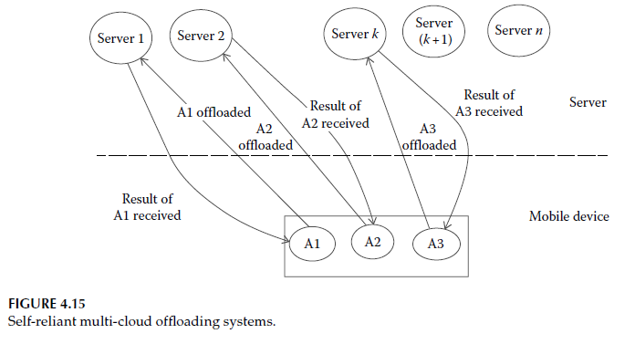
Multi-Cloud Offloading in Mobile Cloud Computing Environment

Slide 48
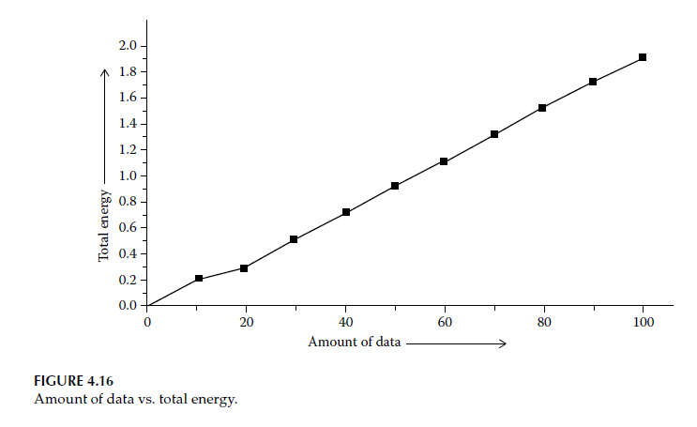
Performance Analysis of Multi Cloud Offloading Schemes
Notes:
The non-cooperative transmission when the amount of data (d) is small can still be better
energy efficient than multiple input, single output. However, when d is larger, energy
consumption is high, as shown in Figure 4.16. The graph underneath shows that when
the amount of data sent to the server is small, the energy requirement is less. It indicates
that the system is more energy efficient. But as the amount of data is increased, the energy
requirement is also increased simultaneously.

Slide 49
Conclusion
Offloading involves power consumption in executing an application and during communication with the remote cloud.
To better utilize the resource on the cloud, there is a trade-off between transmission energy cost and local execution energy cost.
Though many works have made an effort to find the balance point, only a subset of those studies focuses on energy efficiency, while in many cases they merely focus on response time and other resource consumption.
A large part of the researches uses modeling and simulation. Some of the models only offload parts of the program to the server, which reduces transmission cost, while at the same time bringing extra partition overhead.
Other works have focused on transplanting the entire OS or application runtime to the cloud as this ease the burden on external application programmers.

Slide 50
Appendix

Slide 51
Mobile Data Offloading Using Opportunistic Communication
Due to the increasing popularity of different applications for smartphones, 3G cellular networks have become overloaded.
Offloading of mobile data using opportunistic communications is one of the most promising solutions to this problem.
The main advantage of this technique is that it does not require any monetary outlay.
Using opportunistic communications, we can promote information broadcast in mobile social networks (MoSoNets) [11] to reduce the amount of mobile data traffic.
The application of MoSoNets has already expanded from online social networking sites to different powerful mobile applications and mobile social software.

Slide 52
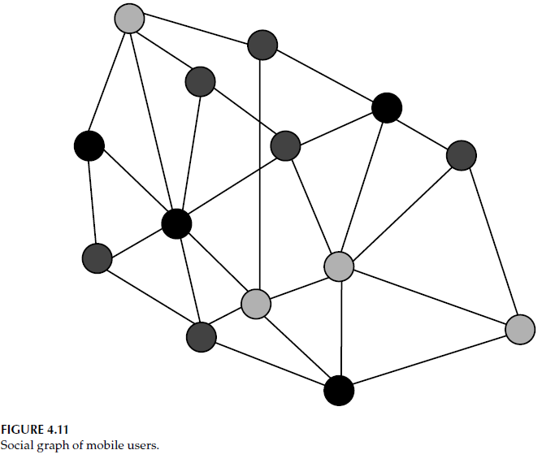
MoSoNets System Model
In MoSoNets, firstly, service providers to deliver the information to only a few selected customers or target users to minimize the mobile data traffic and thus reduce the operation cost.
Then, the information can be further generated by the target users among all other subscribers via social participation, when their smart mobile phones are within the range of communication and opportunistic communication is possible.

Slide 53
Target Sets Selection
For target-set selection problem there are three algorithms
  Greedy
  Heuristic
  Random algorithms
As a comparison among these three algorithms, for all cases, the greedy algorithm performs best followed by the heuristic algorithm
Compared to these two algorithms, a unique advantage of the random algorithm is that service providers need not collect contact information from users.

